Slide 1


JEOPARODY JEOPARODY JEOPARODY JEOPARODY JEOPARODY JEOPARODY JEOPARODY JEOPARODY JEOPARODY JEOPARODY JEOPARODY JEOPARODY JEOPARODY JEOPARODY JEOPARODY JEOPARODY JEOPARODY JEOPARODY JEOPARODY
JEOPARODY JEOPARODY JEOPARODY JEOPARODY JEOPARODY JEOPARODY JEOPARODY JEOPARODY JEOPARODY JEOPARODY JEOPARODY JEOPARODY JEOPARODY JEOPARODY JEOPARODY JEOPARODY JEOPARODY JEOPARODY JEOPARODY

Slide 2

HERE ARE TODAY’S CATEGORIES

Slide 3

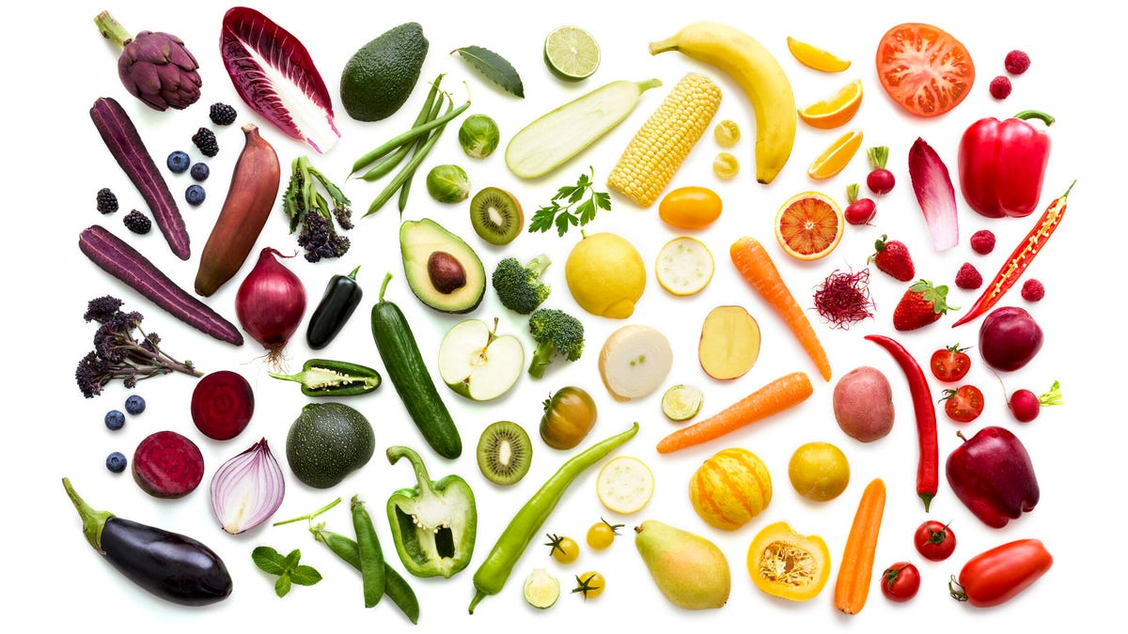
Vitamins

Slide 4
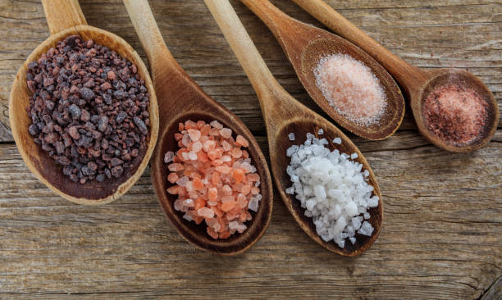
Minerals

Slide 5
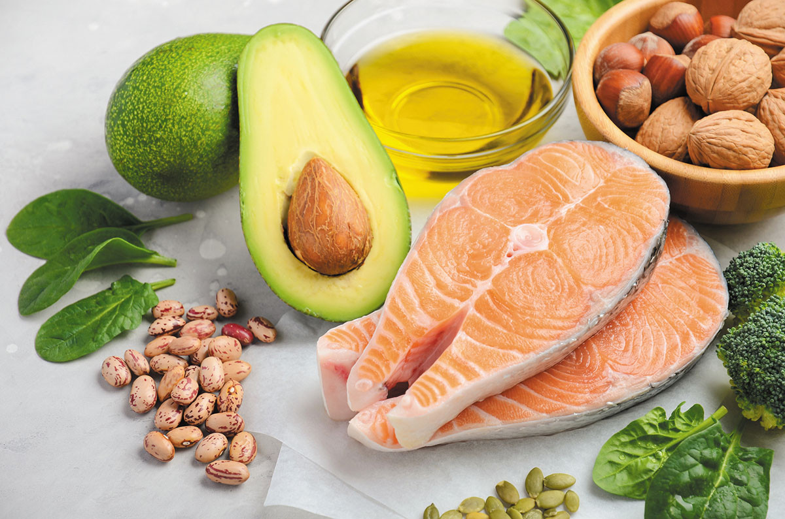
Fats

Slide 6
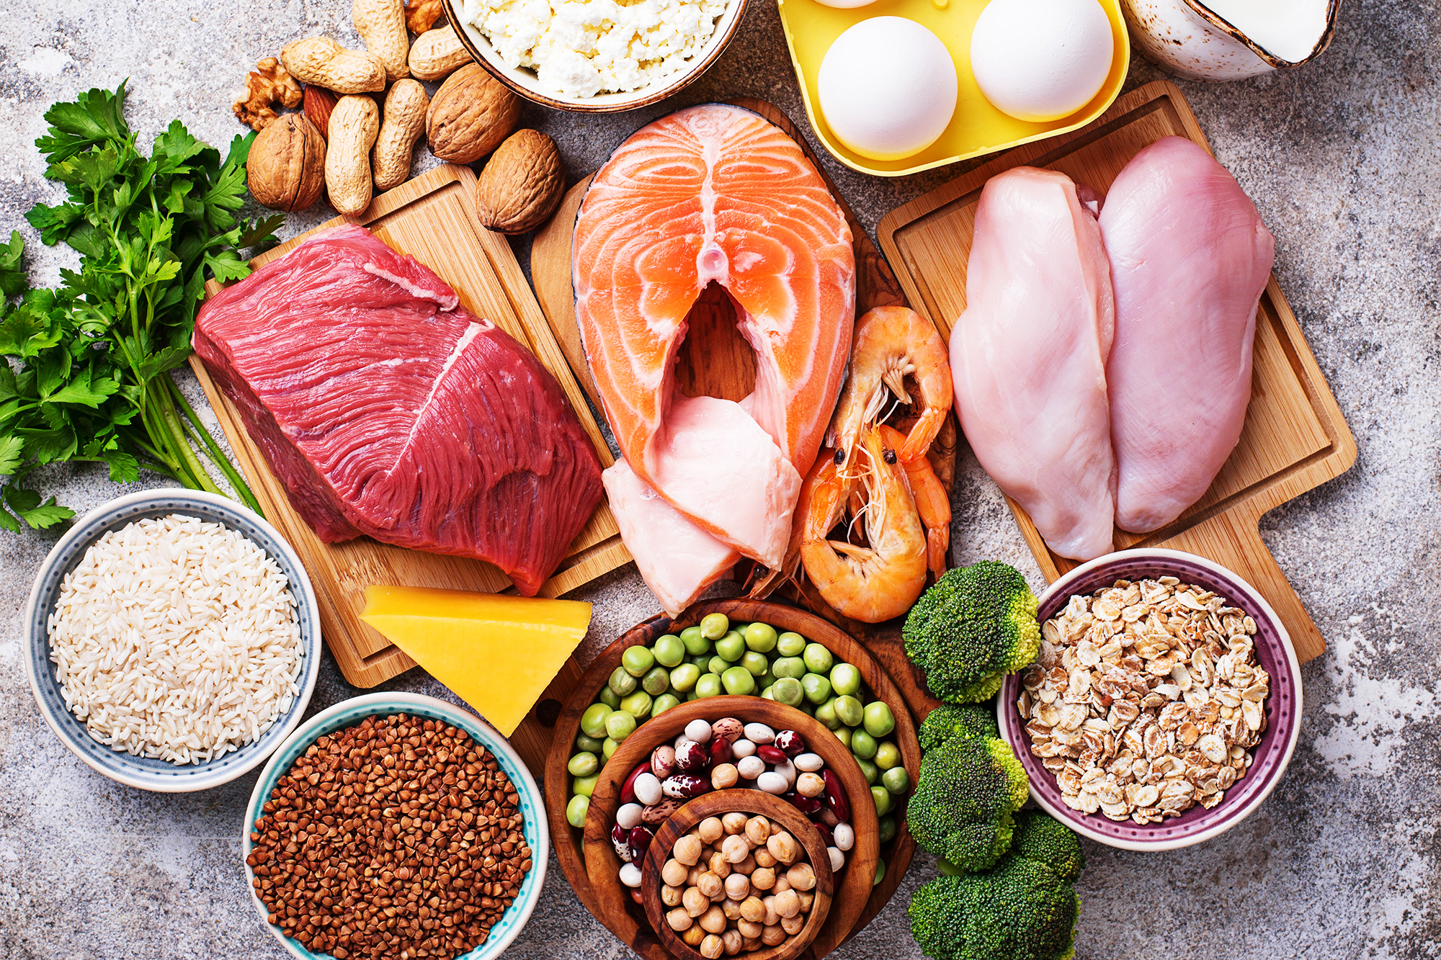
Protein

Slide 7
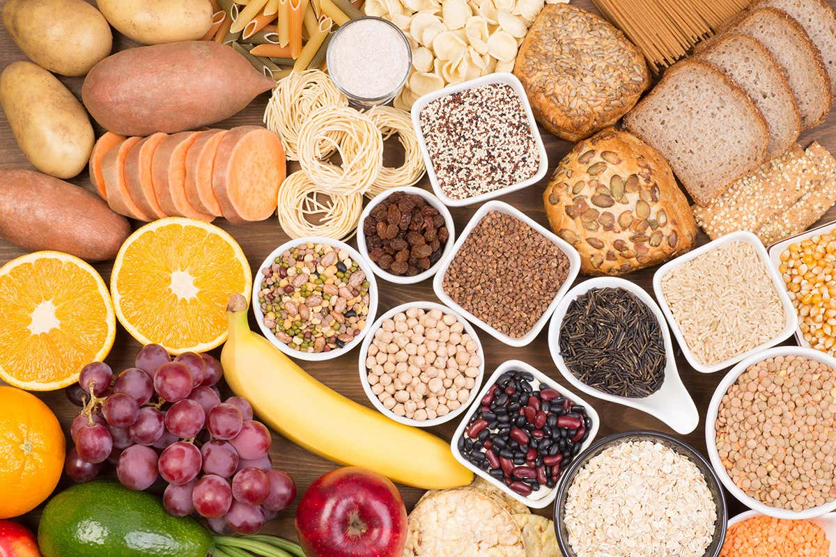
Carbohydrates

Slide 8

Misc

Slide 9
Pre-game Agenda
Each group needs a team name and group leader that will be answering for the team
Each group needs at least 1 medical student and 1 undergraduate student
There should be 3 groups total
Each group should have an answer discussed and written in case a group gets it wrong
Medical students and undergrads will serve a moderators and keep track of points

Slide 10
Nathan’s Jeopardy Rules
Each team will have 60 seconds to come up with an answer after reading
Each team is allowed to phone one undergraduate student and one medical student.
Answers to the jeopardy questions are strictly the answers (no need to form a question)
If a group answers incorrectly, remaining 2 groups will have the OPTION to steal for half the points
Incorrect answers will be penalized the value of the question

Slide 11

Vitamins
Minerals
Fats
Protein
Carbs
Misc
$100
$100
$100
$100
$100
$100
$200
$200
$200
$200
$200
$200
$300
$300
$300
$300
$300
$300
$400
$400
$400
$400
$400
$400
$500
$500
$500
$500
$500
$500
FINAL JEOPARODY

Slide 12
A patient reads a news article that mentions carrots help improve eye health. Which of the following vitamins in carrots are most likely the vitamin promoting eye health?
Vit A
Vit B
Vit C
Vit D
a

Slide 13
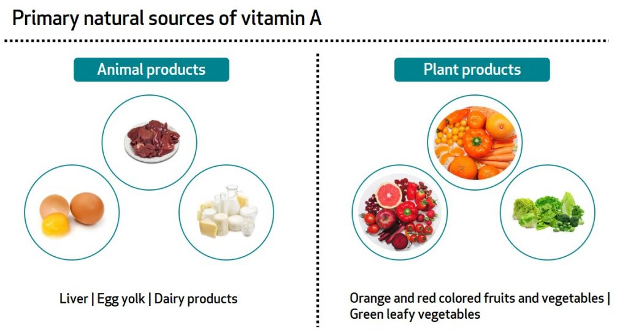
Answer
A patient reads a news article that says carrots help improve eye health. Which of the following vitamins in carrots are most likely the vitamin promoting eye health.
Vit A
Vit B
Vit C
Vit D

Slide 14
Which of the following vitamins are NOT fat soluble?
Vit A
Vit E
Vit C
Vit D

Slide 15

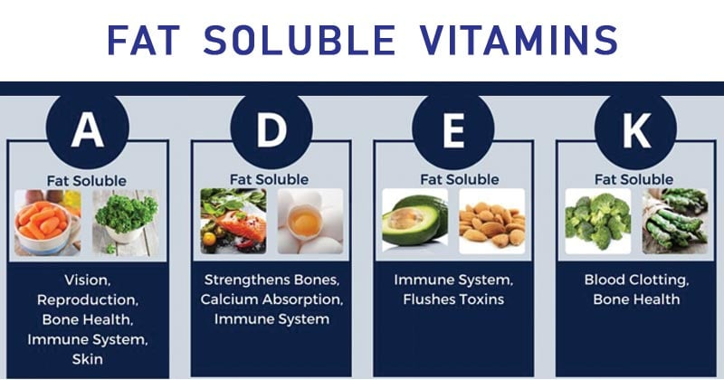
Answer
Which of the following vitamins are NOT fat soluble
Vit A
Vit E
Vit C
Vit D

Slide 16
A nurse goes visit a patient and notices that his gums are swollen, he bruises easily, and has curly hair. The nurse recommends the patient to consume more citrus fruits. What vitamin does the nurse think the patient needs more of?
Vit A
Vit B
Vit C
Vit D

Slide 17
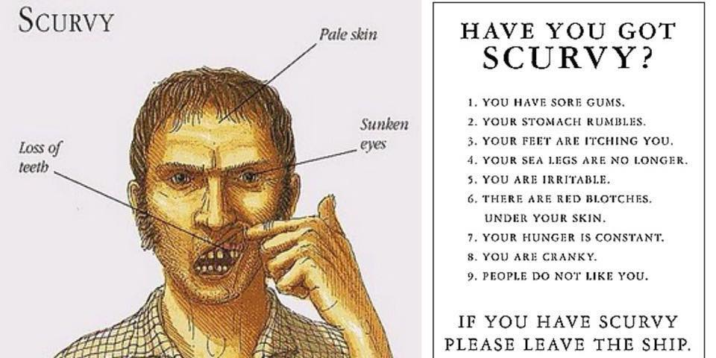
Answer
A nurse goes visit a patient and notices that his gums are swollen, he bruises easily, and has curly hair. The nurse recommends the patient to consume more citrus fruits. What vitamin does the nurse think the patient needs more of?
Vit A
Vit B
Vit C
Vit D

Slide 18
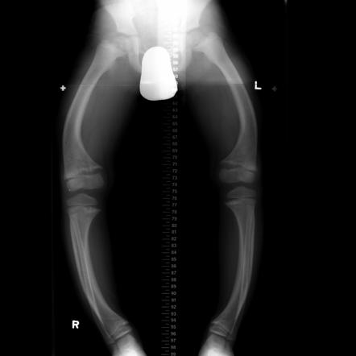
A 6-year-old boy is brought to his pediatrician by his parents due to poor growth and weakness. On physical exam, there is bowing of the legs and tenderness upon palpation of the lower extremity. What Vitamin is he most likely deficient in?
Vit A
Vit B
Vit C
Vit D

Slide 19
Answer
A 6-year-old boy is brought to his pediatrician by his parents due to poor growth and weakness. On physical exam, there is bowing of the legs and tenderness upon palpation of the lower extremity. What Vitamin is he most likely deficient in?
Vit A
Vit B
Vit C
Vit D

Slide 20
A 54 year old comes in complaining of foul-smelling fatty diarrhea. He has a past medical history of alcohol abuse and pancreatitis. Which of the following vitamins will the patient be least likely deficient in:
Vit A
Vit E
Vit C
Vit D

Slide 21
Answer
A 54 year old comes in complaining of foul-smelling fatty diarrhea. He has a past medical history of alcohol abuse and pancreatitis. Which of the following vitamins will the patient be least likely deficient in:
Vit A
Vit E
Vit C
Vit D

Slide 22
A patient comes in comes in with high blood pressure. Which mineral should he/she ingest less of
Calcium
Sulfur
Sodium
Chloride

Slide 23

Answer
A patient comes in comes in with high blood pressure. Which mineral should he/she ingest less of?
Calcium
Sulfur
Sodium
Chloride

Slide 24
A 18 year old female comes in due to fatigue. She mentions that she bleeds a lot during her periods. Which mineral is most likely to improve her symptoms of fatigue.
Sodium
Iron
Calcium
Magnesium

Slide 25
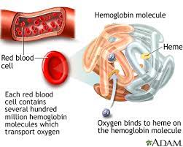
A 18 year old female comes in due to fatigue. She mentions that she bleeds a lot during her periods. Which mineral is most likely to improve her symptoms of fatigue.
Sodium
Iron
Calcium
Magnesium

Slide 26
For someone who wants to reduce the amount of sodium in his or her diet, what food would you recommend avoiding? a. Canned beans b. bananas c. milk d. celery e. sweet potatoes

Slide 27
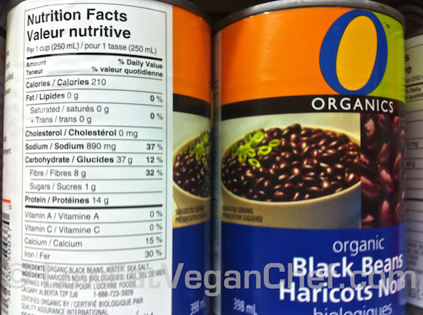
Answer
For someone who wants to reduce the amount of sodium in his or her diet, what food would you recommend avoiding? a. Canned beans b. bananas c. milk d. celery e. sweet potatoes

Slide 28
A deficiency of which mineral is a leading cause of mental retardation worldwide? a. iron b. iodine c. zinc d. chromium

Slide 29
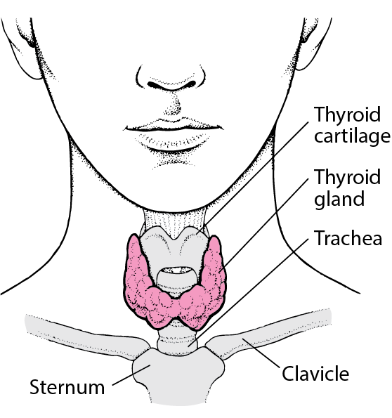
Answer
A deficiency of which mineral is a leading cause of mental retardation worldwide? a. iron b. iodine c. zinc d. chromium

Slide 30
You are a nutritionist looking to improve the performance of an athlete. The athlete mentions he wants to improve his bone health because his family has a history of osteoporosis. Which of the following minerals would have the least impact on bone health.
Calcium
Potassium
Phosphorous
Vit D

Slide 31
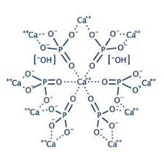
Answer
You are a nutritionist looking to improve the performance of an athlete. The athlete mentions he wants to improve his bone health because his family has a history of osteoporosis. Which of the following minerals would have the least impact on bone health.
Calcium
Potassium
Phosphorous
Vit D

Slide 32
Eating three servings of a food labeled "0 grams of trans fat per serving" can contribute up to 1.5 grams of trans fat.
a. True b. False
c. Only if the product is in violation of the FDA

Slide 33
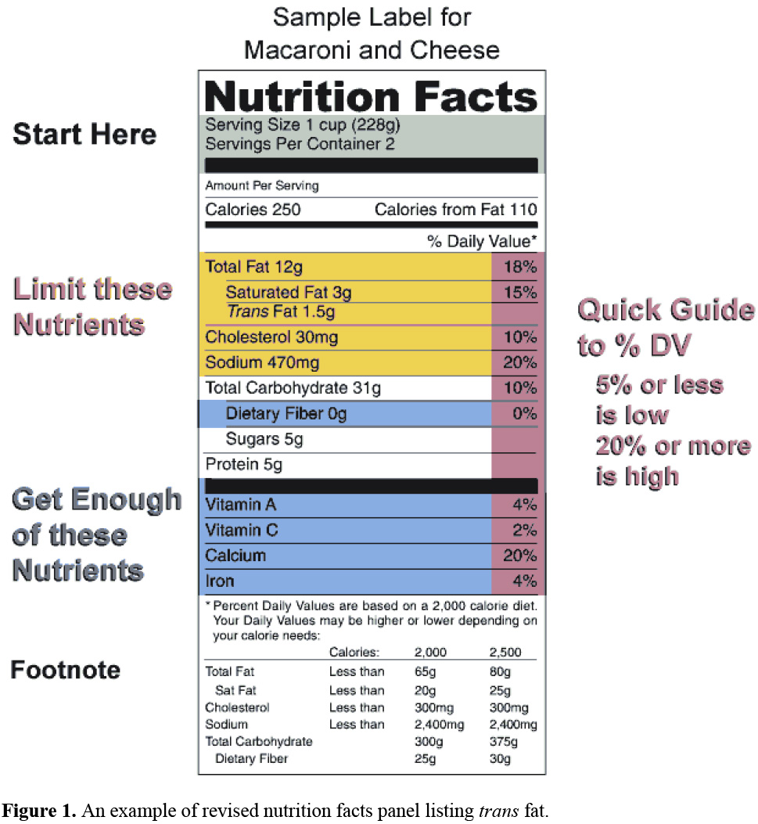
Answer
Eating three servings of a food labeled "0 grams of trans fat per serving" can contribute up to 1.5 grams of trans fat. a. True b. False

Slide 34
The class of nutrient that is necessary for production of certain hormones and that form a coating on the nerves is:
A) Carbs
B) Proteins
C) Fats
D) Minerals

Slide 35
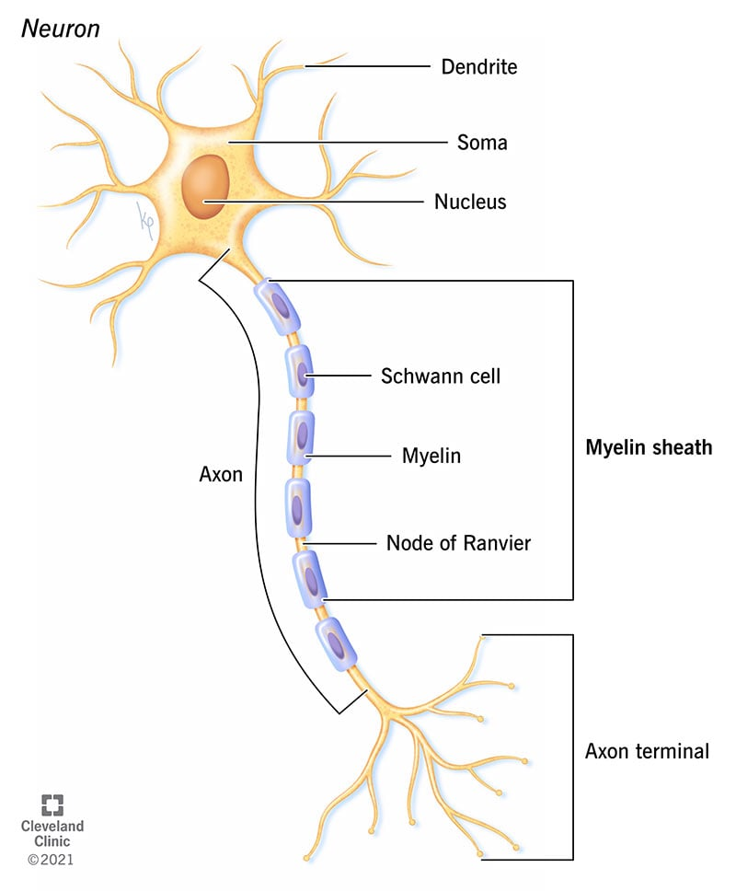
Answer
The class of nutrient that is necessary for production of certain hormones and that form a coating on the nerves is:
A) Carbs
B) Proteins
C) Fats
D) Minerals

Slide 36
Which fat can be found in fish and is the reason fish has been known to improve heart health?
Unsaturated Fat
Saturated fat
Omega-9 Fatty acid
Omega-3 Fatty acid

Slide 37
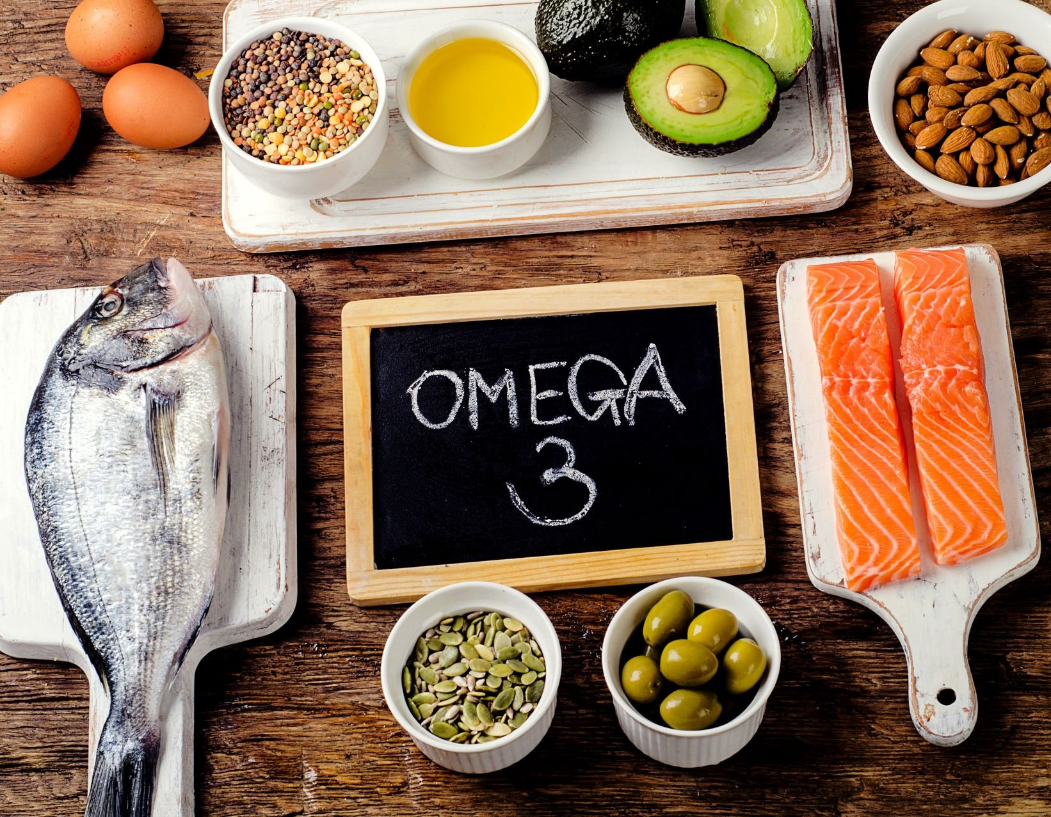
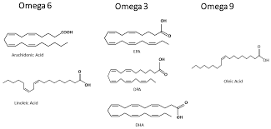
Answer
Which fat can be found in fish and is the reason fish has been known to improve heart health?
Unsaturated Fat
Saturated fat
Omega-9 Fatty acid
Omega-3 Fatty acid

Slide 38
What is a primary function of fat in the body? a. Fats are stored as glycogen, the body's form of stored energy. b. Fats are converted to proteins as needed. c. Fats protect internal organs from overheating. d. Fats provide the energy to fuel muscular work.

Slide 39
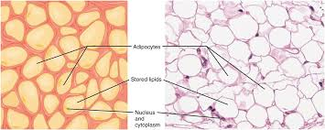
Answer
What is a primary function of fat in the body? a. Fats are stored as glycogen, the body's form of stored energy. b. Fats are converted to proteins as needed. c. Fats protect internal organs from overheating. d. Fats provide the energy to fuel muscular work.

Slide 40
Which of the following plant oils is (are) highly saturated? a. peanut oil and sesame oils b. canola oil c. palm and coconut oils d. olive oil

Slide 41
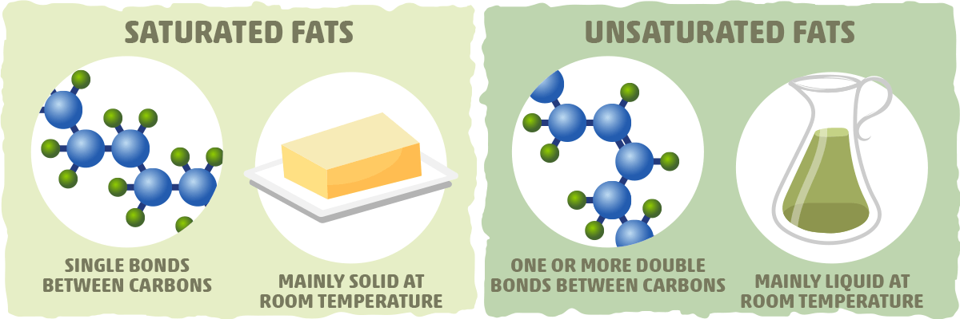
Answer
Which of the following plant oils is (are) highly saturated? a. peanut oil and sesame oils b. canola oil c. palm and coconut oils d. olive oil

Slide 42
The basic building block of a protein is an:
Starch
Amino Acid
Glucose
Lipid

Slide 43
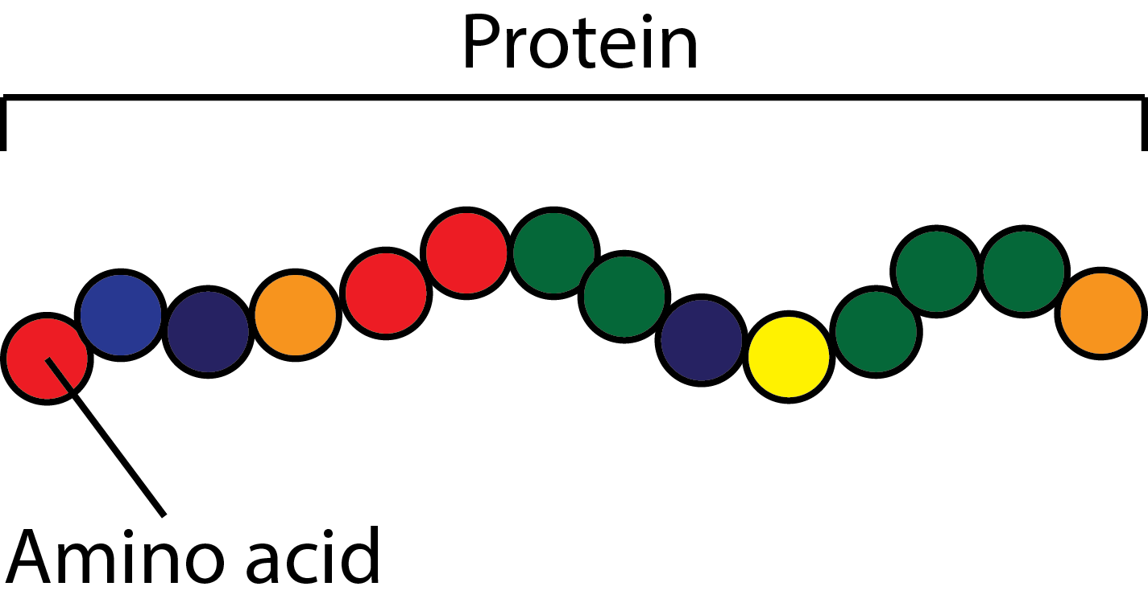
Answer
The basic building block of a protein is an:
Starch
Amino Acid
Glucose
Lipid

Slide 44
Which function of proteins can also be performed by carbohydrates and fats?
Build muscle
Carry iron and oxygen in the blood
Enzyme synthesis
Provide energy

Slide 45

Answer
Which function of proteins can also be performed by carbohydrates and fats?
Build muscle
Carry iron and oxygen in the blood
Enzyme synthesis
Provide energy

Slide 46
A burn patient is recovering after spending 5 days in the intensive care unit. She is looking to increase her protein intake. Which of the following single foods has the most complete source of protein?
Beans
Fish
Peanuts
Broccoli

Slide 47
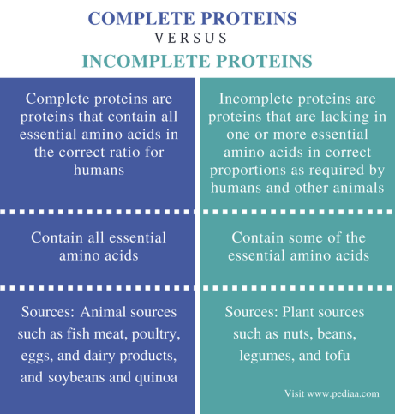
Answer
A burn patient is recovering after spending 5 days in the intensive care unit. She is looking to increase her protein intake. Which of the following single foods has the most complete source of protein?
Beans
Fish
Peanuts
Broccoli

Slide 48
Why is protein important in the diet? A) it supplies amino acids the body uses as raw materials to form its own proteins B) it supplies high levels of glucose that help support the brain C) A and B D) protein helps dissolve fat-soluble nutrients

Slide 49
Answer
Why is protein important in the diet? A) it supplies amino acids the body uses as raw materials to form its own proteins B) it supplies high levels of glucose that help support the brain C) A and B D) protein helps dissolve fat-soluble nutrients

Slide 50
A 22 year old body builder decides to consume 200 grams of protein per day before his competition. Where is the protein from diet stored in the body?
a. Liver cells b. Muscle cells
c. Bone matrix
d. Both A and B e. None of the above

Slide 51
Answer
A 22 year old body builder decides to consume 200 grams of protein per day before his competition. Where is the protein from diet stored in the body? a. Liver cells b. Muscle cells
c. Bone matrix
d. Both A and B e. None of the above

Slide 52
What is the primary function of insulin? A. Raises blood glucose levels B. Lowers blood glucose levels C. Stimulates glycogen breakdown D. Stimulates intestinal carbohydrate absorption

Slide 53
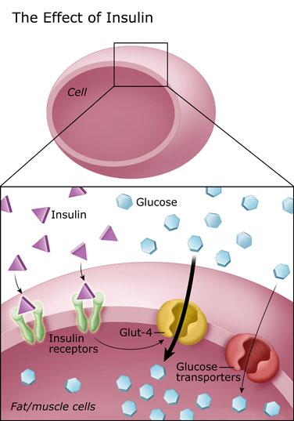
Answer
What is the primary function of insulin? A. Raises blood glucose levels B. Lowers blood glucose levels C. Stimulates glycogen breakdown D. Stimulates intestinal carbohydrate absorption

Slide 54
A 18 year old athlete is trying to lose weight by reducing her carbohydrate intake. She asks your help to understand what exactly is a carbohydrate. Which of the following is NOT considered a carbohydrate?
Sugar
Fiber
Glucose
Amino acid

Slide 55
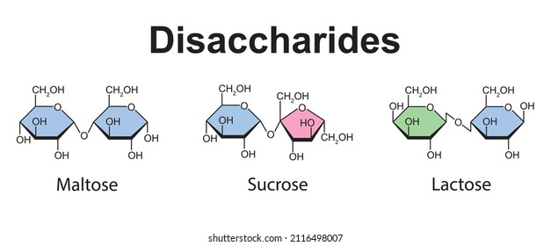
Answer
A 18 year old athlete is trying to lose weight by reducing his carbohydrate intake. He asks your help to understand what exactly is a carbohydrate. Which of the following is NOT considered a carbohydrate?
Sugar
Fiber
Glucose
Amino acid

Slide 56
A 6 year old child is brought by his mother due to the clinic for consistent diarrhea. The mother states that his diarrhea happens every time her child eats cereal. Which carbohydrate is most likely the cause of the child’s diarrhea.
Sucrose
Glucose
Lactose
Fiber

Slide 57

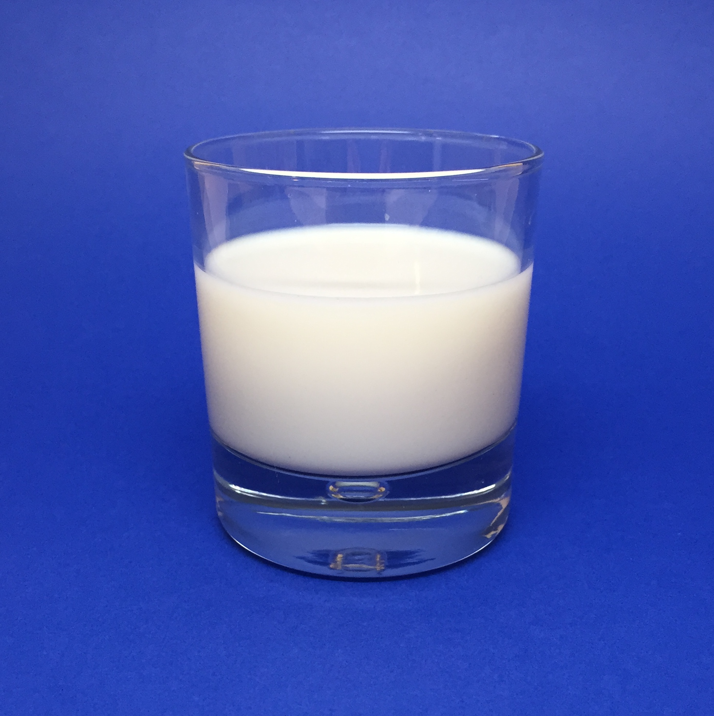
Answer
A 6 year old child is brought by his mother due to the clinic for consistent diarrhea. The mother states that his diarrhea happens every time her child eats cereal. Which carbohydrate is most likely the cause of the child’s diarrhea.
Sucrose
Glucose
Lactose
Fiber

Slide 58
A 32 year old man recently has been diagnosed with Type 2 Diabetes. He learns how diabetes can damage your heart, kidney, and eyes. Intake of which of the following nutrients should he try to minimize the most of?
100% Natural Cranberry Juice
Vitamin C
Steak
Fiber

Slide 59
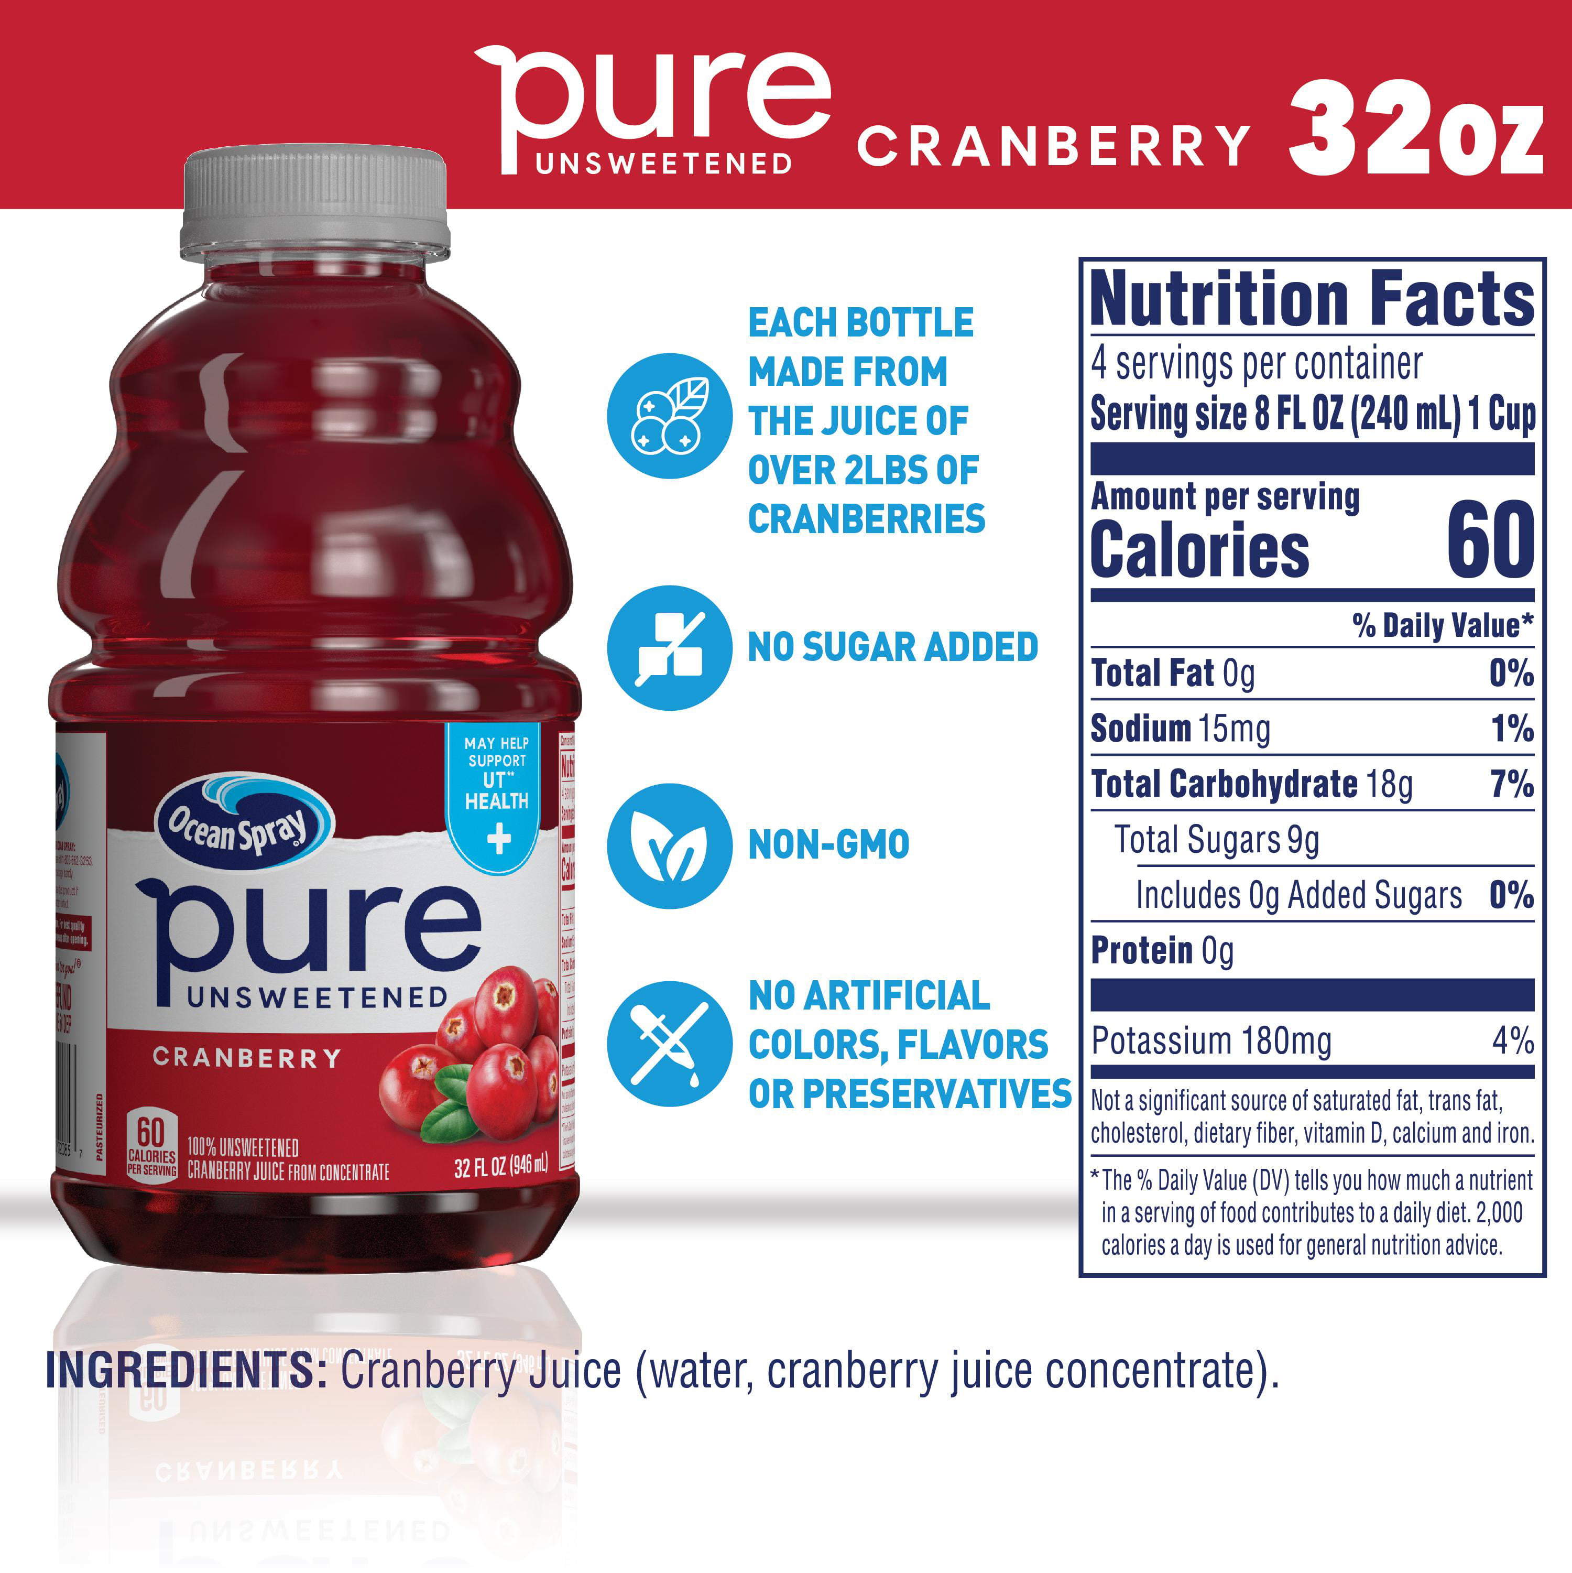
Answer
A 32 year old man recently has been diagnosed with Type 2 Diabetes. He hears the long term side effects of diabetes, and how it can damage your heart, kidney, and eyes. Intake of which of the following nutrients should he try to minimize
100% Natural Cranberry Juice
Vitamin C
Steak
Fiber

Slide 60
A high school student is preparing for his ACT test. He reads online that it is important that the brain has enough energy during the exam. Knowing this, which food is he most likely to benefit from during the exam?
Celery
French Fries
Peanut butter
Avocado

Slide 61
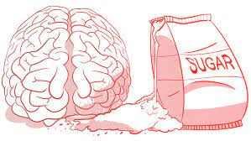
Answer
A high school student is preparing for his ACT test. He reads online that it is important that the brain has enough energy during the exam. Knowing this, which food is he most likely to benefit from during the exam?
Celery
French Fries
Peanut butter
Avocado

Slide 62
What is the safest BMI for most people?
Under 20
20-25
25-27
27 +

Slide 63
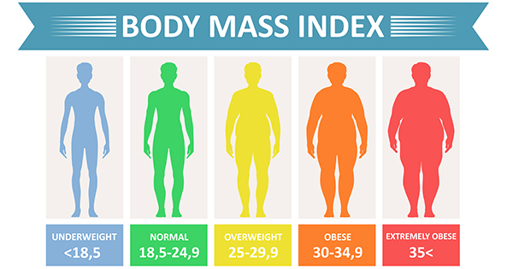
Answer
What is the safest BMI for most people over 18?
Under 20
20-25
25-27
27 +

Slide 64
Which of the following groups of nutrients provide energy in the diet?
Carbohydrate, lipid, proteins
Carbohydrate, proteins, vitamins
Carbohydrates, lipids, minerals
All of the above

Slide 65
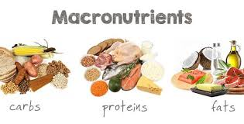
Answer
Which of the following groups of nutrients provide energy in the diet?
Carbohydrate, lipid, proteins
Carbohydrate, proteins, vitamins
Carbohydrates, lipids, minerals
All of the above

Slide 66
A hunter and gatherer is preparing for the harsh cold winter. Which of the given nutrients will provide him the most energy during times of famine?
Vitamins
Fats
Proteins
Carbohydrates

Slide 67
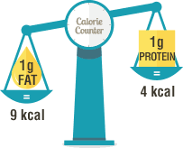
Answer
A hunter and gatherer is preparing for the harsh cold winter. Which of the given nutrients will provide him the most energy during times of famine?
Vitamins
Fats
Proteins
Carbohydrates

Slide 68
Which one of the following does the Food and Drug Administration (FDA) approve?
Dietary supplements for safety and effectiveness
Infant formula
Cosmetics
Nutrition fact labels

Slide 69
Answer
Which one of the following does the Food and Drug Administration (FDA) approve?
Dietary supplements for safety and effectiveness
Infant formula
Cosmetics
Nutrition fact labels

Slide 70
What is a calorie?
The amount of heat needed to raise the temperature of 1 gram of water 1 degree Celsius
1/10 of a pound
The amount of water needed to cool 1 pound of ignited food product
The amount of heat needed to raise 1 pound of an organism 1 degree Celsius

Slide 71
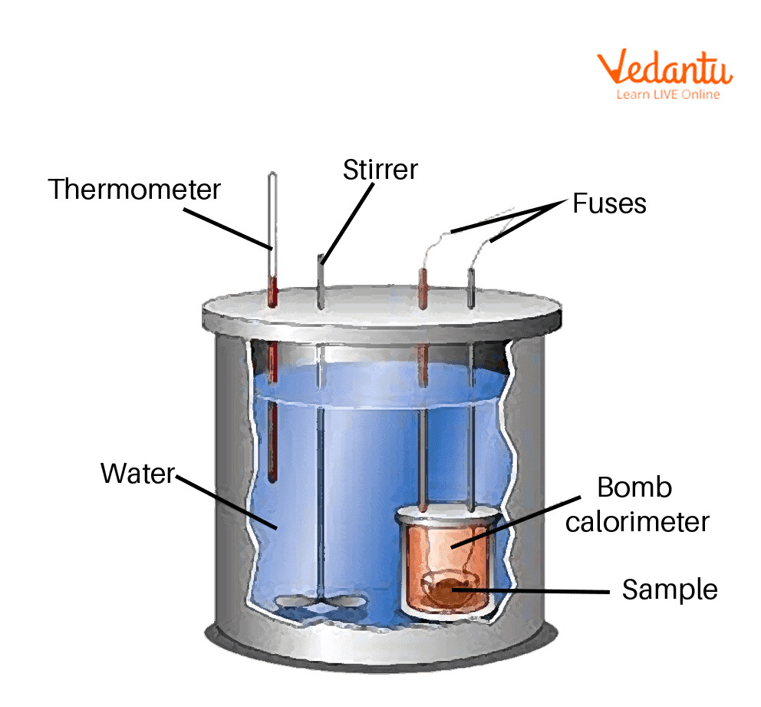
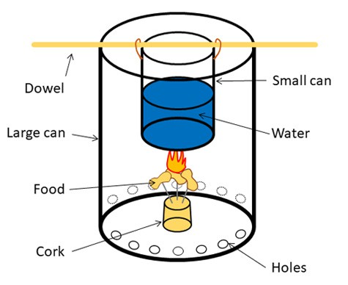
Answer
What is a calorie?
The amount of heat needed to raise the temperature of 1 gram of water 1 degree Celsius

Slide 72


Slide 73
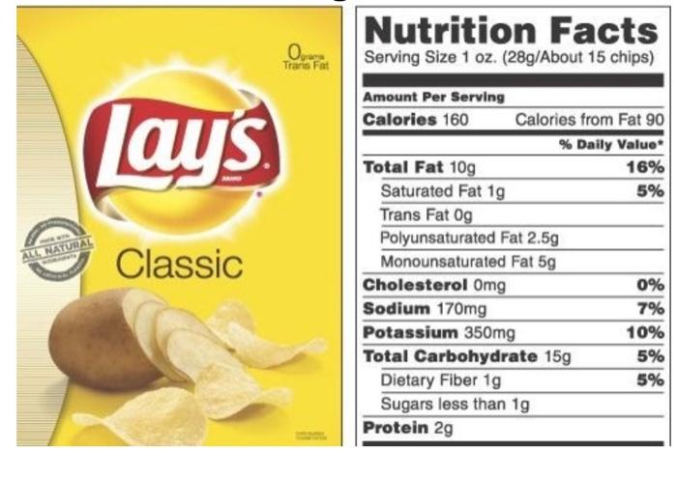
You are eating a bag of chips with the Nutrition Facts below as a reward for a week of good eating. Utilizing the percentage off error the FDA allows, the is the maximum number of calories the bag could contain?
GO TO
PROMPT
(RESPONSE)
Start Timer

Slide 74
160/2 x 1.2= 96

Slide 75
Contact
Nathan Shen
Shen1n@cmich.edu

